Slide 1
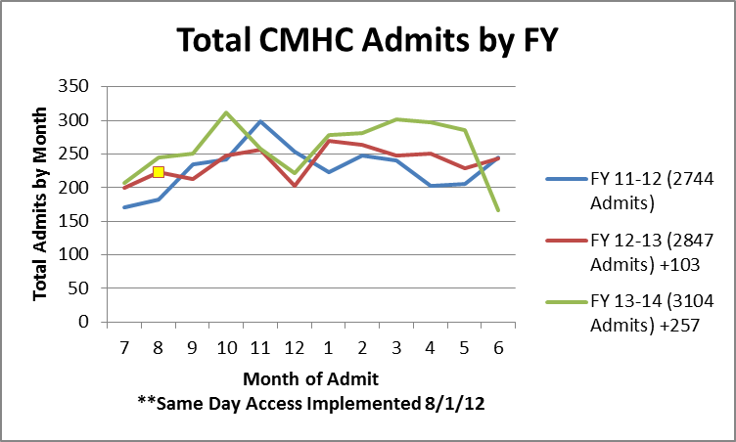
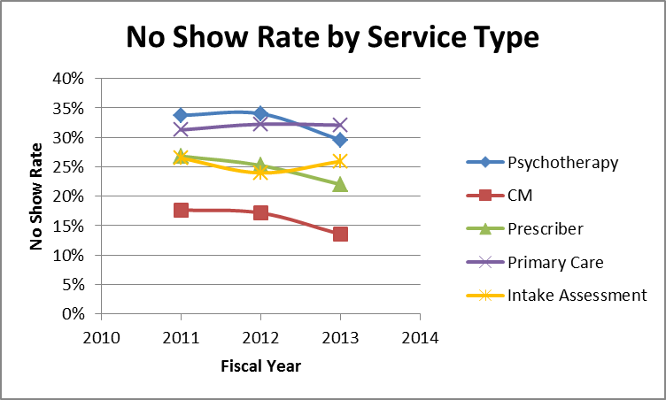
Using Internal Evaluation to Aid Appointment Scheduling Practices: Increasing Capacity, No Show Rates and Staff Kept Rates
James Linderman, MA CAC III
Mental Health Center of Denver
Background
Overall No Show/Staff Kept Rates
Admissions by Month and FY
The Mental Health Center of Denver (MHCD) transitioned to a Same Day Access system in August, 2012 which allowed consumers to access services same day, rather than scheduling intake appointments days or weeks in advance.
MHCD was selected to participate in a 10 month long (Aug 12-May 13) MTM consultation in conjunction with this transition and MHCD Evaluation Department provided data collection and analysis to aid consultation.
Data around performance indicators was reviewed on a monthly basis with key program staff, executive management and MTM consultant in order to drive decisions.
Basis of Same Day Access implementation is that services received at intake would impact MHCD system as a whole.
Attendance Coding in System:
(1-Appt Kept, 2-Walk-In/Unscheduled, 3-Emergency, 4-Cancelled by Consumer, 5-Cancelled by Staff, 6-No Show)
Consumer No Show Rate Formula: (No Show)/(Appt Kept + No Show)
1) Get % by Consumer, Team, Staff, Service Code, Organization, Time of Day
2) Any No Show Appt raised % from 0
Staff Kept Rate Formula:
(Appt Kept + Cancelled by Consumer + No Show)/(Appt Kept + Cancelled by Consumer + Cancelled by Staff + No Show)
1) Get % By Staff, Team, Service Code, Organization
2) Any Cancelled by Staff notes lowered % from 100
Identification of Goals
**MTM goal for No Show (10%) and Staff Kept (90%) Rates
Breakup by Service Type
Discussion and Future Plans
1) Worked with MTM consultant on coming up with an organizationally accepted definition for Staff Kept and No Show Rates that allows MHCD to monitor efficiency in providing services.
2) Assess MHCD’s current Staff Kept and No Show percentage rates and identify specific services that can be impacted.
3) Track admissions per month and see if any increase with addition of Same Day Access system.
Overall philosophy as suggested by MTM is that if MHCD staff are consistent with keeping appointments as scheduled, consumers will be more likely to show for appointments. If staff are keeping appointments and there are still high no show rates, focus can be shifted to outreach methods, i.e. designating staff that focus on just outreach, discussing in supervision how to engage high no show rate consumers, alternative scheduling for those that continue to have high no show rates.
In addition if a consumer is able to access services when they are seeking help, they will hopefully be more invested and likely to participate throughout course of treatment.
Staff Kept Rates were above goal (90% or above) and weren’t as much of a concern (staff not cancelling appointments often).
Overall No Show Rates close to goal (10% or below) and appear to be declining and moving in right direction, 15.50%-13.37%.
No Show Rates by service seem to be higher in general for Prescribers, Psychotherapy, Primary Care (25% or above). For most part, no show rates by service are declining since Same Day Access except for Primary Care and Intake Assessment.
Number of admissions have increased each fiscal year and appear to be increasing more steadily since Same Day Access implementation (+257 FY 13-14, compared to +103 FY 12-13).
MHCD appears to be on right track at this point for reducing no show rates to eventually under 10%, keeping staff kept rates above 90% and increasing intakes each FY.
Suggestions for Future: Same Day Alternative Scheduling for consumers with 3 consecutive no shows, looking at unused appointment blocks, differences in time of day, cost of missed appointment for each provider.
Acknowledgements Joy Fruth, MTM Services
www.mtmservices.org
National Council for Community Behavioral Healthcare www.thenationalcouncil.org
Identified differences between appointments that are scheduled electronically (Psychotherapy, Prescriber, Primary Care, Intake Assessment) versus those not scheduled electronically (CM).
Some services face more challenges than others, i.e. PCP who sees consumers less frequently (once a year or less) than a CM or prescriber.
Identified administrative processes that influence No Show Rates, i.e. front desk staff scheduling appointments versus clinicians, scheduling appointments months out, 24 hour reminder policy versus 48 or 72, different policies for each program, etc.
Reviewed attendance policy expectation for consumers as well as staff. For consumers what is our expectation of their attendance and for staff, how far out should appointments be scheduled?

